Slide 1
Welcome! Crowley and Co. PC
Benjamin Carella, Lin Chen, Holly Freed, Daniel Ministero

Slide 2
We Will Discuss…
Team Background
Crowley and Co. PC
Our Business Expert- Holly Freed
Crowley’s Current Data Collection System
Potential Issues with their current system
Our Proposed Database Sample
Backup Strategy and Future Enhancements
Conclusion

Slide 3
Background
Benjamin Carella
Junior, Business Administration-Finance
Lin Chen
Junior, Business Administration-MIS
Holly Freed (Business expert)
Senior, Accounting Major
Daniel Ministero
Senior, Accounting

Slide 4
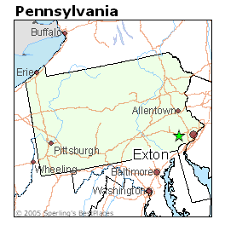
D. Crowley and Co. PC
Founder is David B. Crowley, CPA
Located in Exton, Pennsylvania
Established in 1998
Certified Public Accountants specializing in Tax
Six employees

Slide 5
Our Business Expert… Holly Freed
Holly is an Accounting major
She works primarily from home for Crowley and Co.
Periodically travels to the office in Exton (several times per year) during more hectic season
Holly has worked for Mr. Crowley for fifteen years
Her primary job responsibility involves reviewing tax returns

Slide 6
Current Data Collection System
Currently, customer information is primarily kept in Dave Crowley’s cell phone
Phone numbers, addresses, e-mail addresses
There is a single running Word document that lists each client of the firm and which associate is responsible for a particular client
The list is updated periodically and sent via e-mail to the firm’s associates

Slide 7
Problems with this Current Format
Currently, it is very inconvenient for employees to have to interrupt Dave to obtain client information
Sometimes, he may be in a meeting or on the phone with a client
Client information is not kept in one centralized location
It is time consuming and inconvenient for associates
Much of the information is kept in the manager’s address book or cell phone, which could be lost, damaged, or corrupted

Slide 8
Our Database Sample

Slide 9
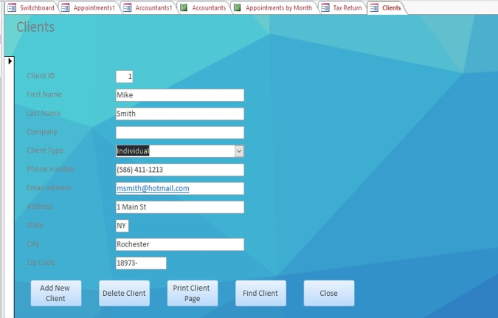
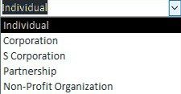
Forms

Slide 10
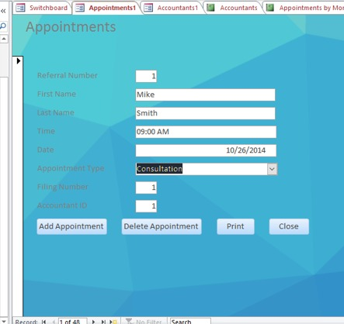

Slide 11
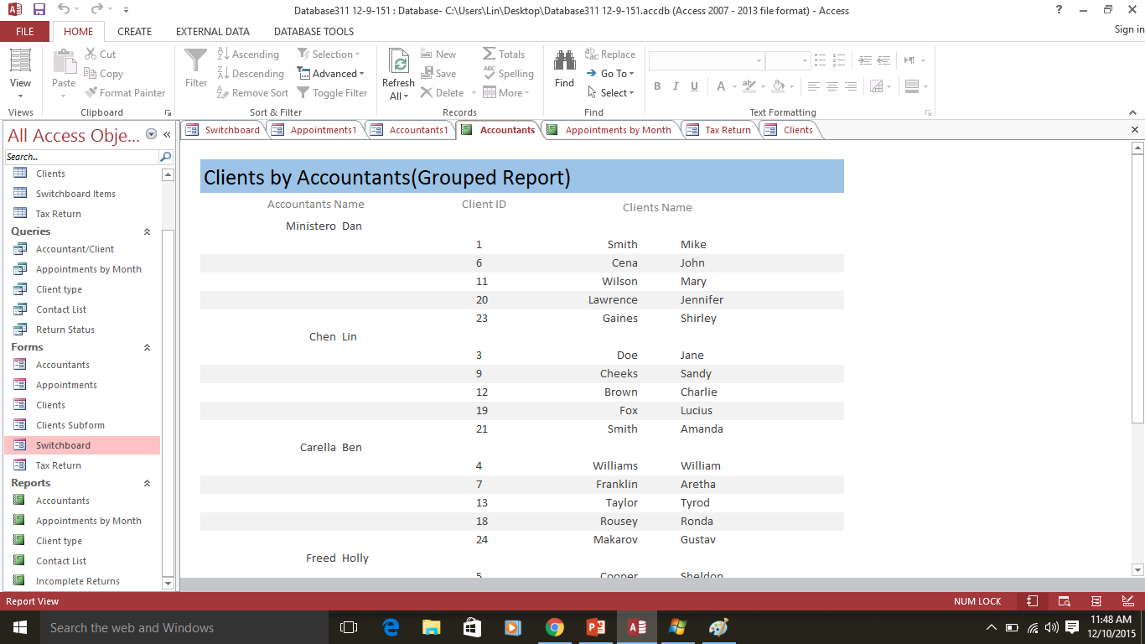
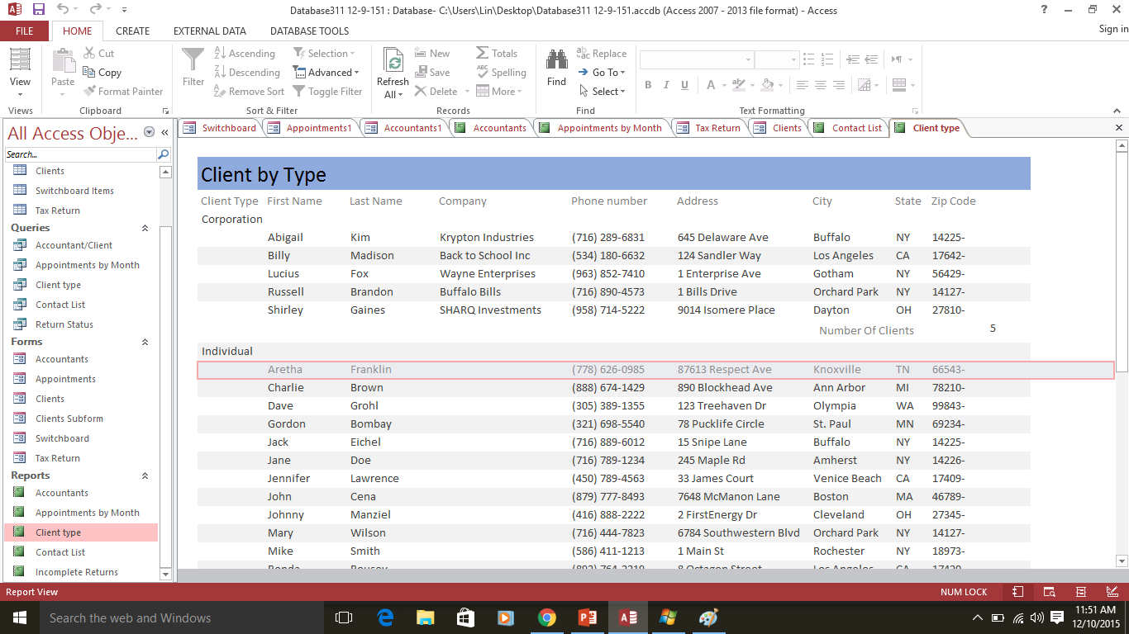
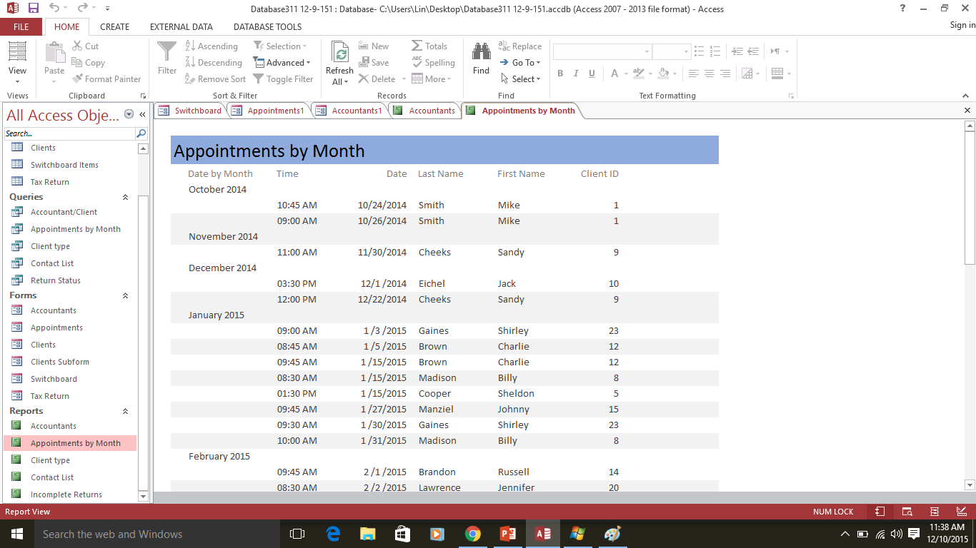

Slide 12
Our Proposed System
Reports:
Accountant-Client (grouped)
Appointments by Month
Client Type (summary)
Contact List
Incomplete Returns
Forms:
Accounts
Client subform
Clients
Appointments
Tax Returns
Benefits of the New system:
Much more efficient than Crowley’s current data collection practices
Client information can be found in one safe place
Database is available to all associates
Won’t have to bother the manager

Slide 13
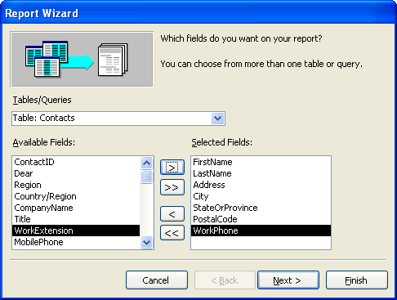
Extra Features…
Featured dropdowns in multiple fields in tables
Conditional formatting in the Tax Return form
Completed returns’ status are highlighted in Green
Customized backgrounds for Switchboard and form
Used grouped query
Multiple pages on the group website

Slide 14
Backup Strategy and Future Enhancements
In the future, we can make our reports more in-depth and specialized
Continue to update tables with new client information
Can be done much more easily with our new system
Ensure that the database is saved in multiple locations
For example, through the company IT system as well as on a flash drive
Print out weekly reports to keep associates informed

Slide 15
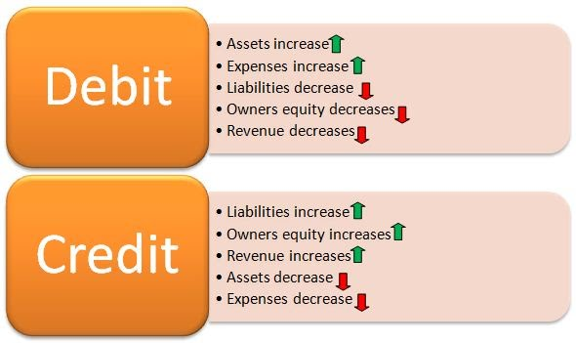
In Closing…
Our proposed database is much more efficient than Crowley and Co.’s current data collection
The new system will be much more convenient for Mr. Crowley and his associates
Under this plan, updates and enhancements of the system can be made as necessary

Slide 16
Any Questions?

